Slide 1
Project Management
CT050-3-3-PRMGT
02: Introduction – Aligning Projects with Business Strategy

Slide 2
Topic & Structure of The Lesson

Slide 3
Learning Objectives
Describe the importance of aligning projects with business strategy, the strategic planning process, and using a SWOT analysis
Explain two different approaches to the project planning process—a four-stage traditional approach and an agile approach
Summarize the various methods for selecting projects and demonstrate how to calculate net present value, return on investment, payback, and the weighted score for a project
Discuss the program selection process and distinguish the differences between programs and projects
Describe the project portfolio selection process and the five levels of project portfolio management

Slide 4
Key Terms You Must Be Able To Use
If you have mastered this topic, you should be able to use the following terms correctly in your assignments and exams:
xxxx

Slide 5
Aligning Projects with Business Strategy
Most organizations cannot undertake most of the potential projects identified because of resource limitations and other constraints
An organization’s overall business strategy should guide the project selection process and management of those projects

Slide 6
SWOT Analysis
SWOT analysis involves analyzing Strengths, Weaknesses, Opportunities, and Threats
It can help you identify potential projects, as is shown in the example about four people trying to start a new business

Slide 7
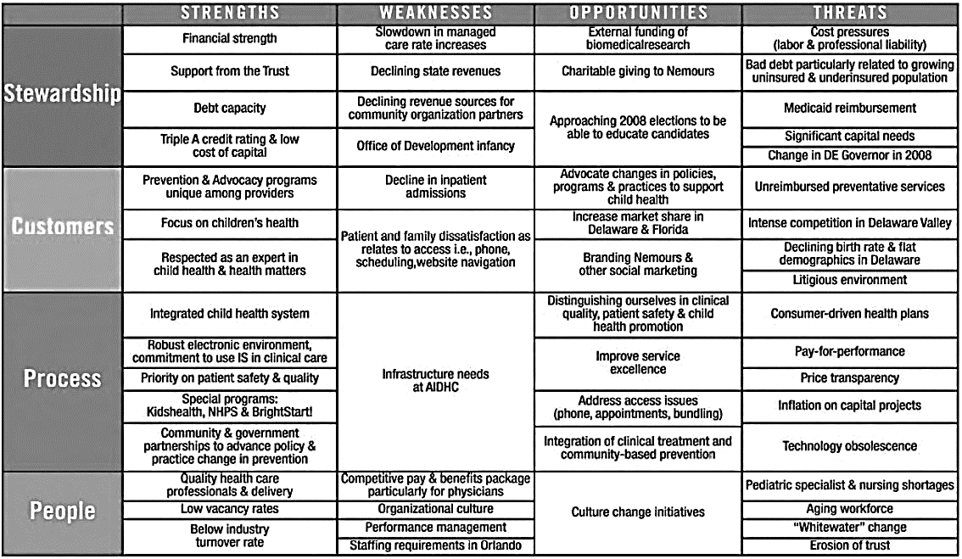
Figure 2-1. Sample SWOT Analysis (Nemours)

Slide 8
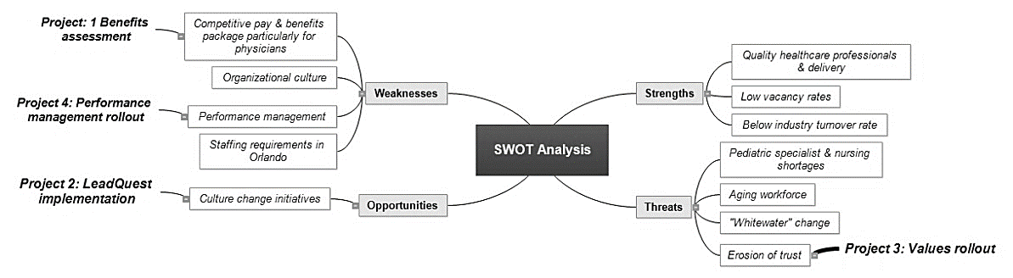
Figure 2-2. Mind Map of a SWOT Analysis to Help Identify Potential Projects (Created with MatchWare’s MindView Business Edition)

Slide 9
Traditional And Agile Approaches To Project Planning
Many organizations follow a traditional approach, often completed in four stages
To make more timely decision, they may also use an agile approach

Slide 10
Traditional Project Planning Process
Organizations often follow a detailed planning process for project selection, often done on an annual basis
Figure 2-3 shows a four-stage planning process for selecting projects
It is very important to start at the top of the pyramid to select projects that support the organization’s business strategy

Slide 11
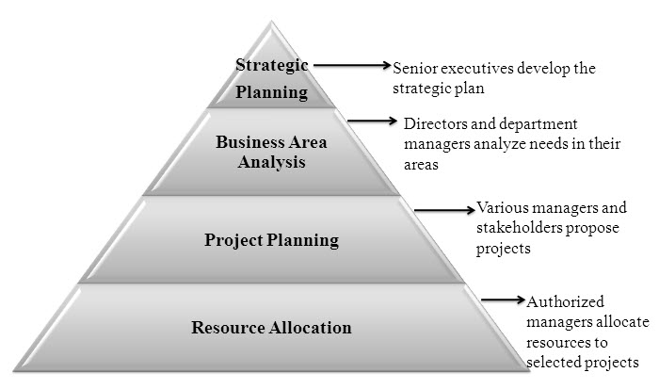
Figure 2-3. Pyramid for a Traditional Project Planning Process

Slide 12
An Agile Mindset for Project Planning
In contrast to the traditional, top-down planning approach, an agile planning approach is much more flexible and allows teams to provide feedback to strategy which can influence a change in direction
Instead of selecting and funding a specific project, the corporation defines the strategic direction, funds teams, and entrusts them to figure out the best approach to define and deliver the greatest business value

Slide 13
Methods for Selecting Projects
Focus on competitive strategy and broad organizational needs
Perform net present value analysis or other financial projections
Use a weighted scoring model
Implement a balanced scorecard
Address problems, opportunities, and directives
Consider project time frame
Consider project priority

Slide 14
Performing Financial Projections
Financial considerations are often an important aspect of the project selection process
Three important methods include:
Net present value analysis
Return on investment
Payback analysis

Slide 15
Net Present Value Analysis
Net present value (NPV) analysis is a method of calculating the expected net monetary gain or loss from a project by discounting all expected future cash inflows and outflows to the present point in time
NPV means the return from a project exceeds the opportunity cost of capital—the return available by investing the capital elsewhere
Projects with higher NPVs are preferred to projects with lower NPVs if all other factors are equal

Slide 16
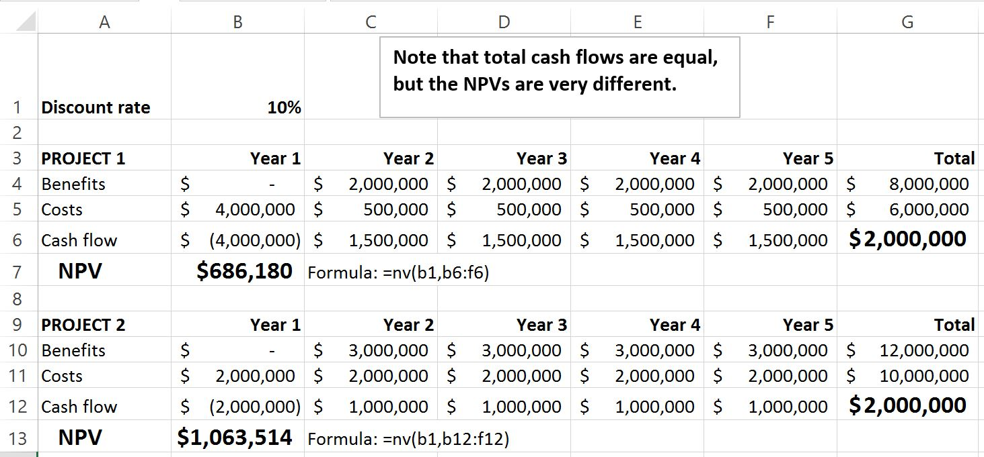
Figure 2-5. Net Present Value Example

Slide 17
Figure 2-6. Detailed NPV Calculations

Slide 18
NPV Considerations
Some organizations refer to the investment year(s) for project costs as Year 0 instead of Year 1 and do not discount costs in Year 0
The discount rate can vary, based on the prime rate and other economic considerations.
You can enter costs as negative numbers instead of positive numbers, and you can list costs before benefits
Project managers should check to see which approaches their organizations prefer when calculating NPV

Slide 19
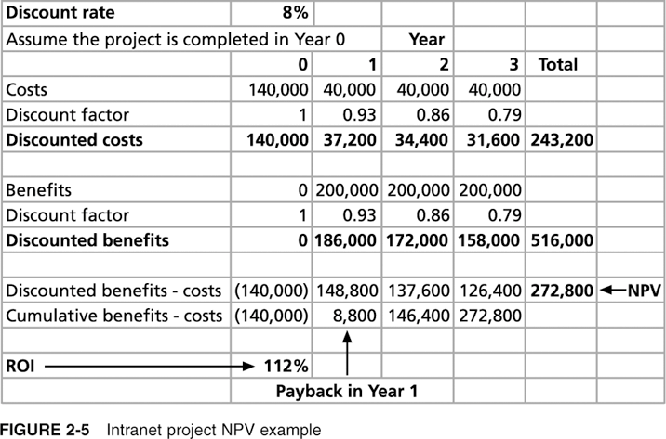
Figure 2-7. Intranet Project NPV Example
Schwalbe, Information Technology Project Management, Sixth Edition, 2010

Slide 20
Steps for Calculating NPV
Determine the estimated costs and benefits for the life of the project and the products it produces.
Determine the discount rate. A discount rate is the rate used in discounting future cash flows. The annual discount factor is a multiplier for each year based on the discount rate and year (calculated as 1/(1+r)t, where r is the discount rate, and t is the year).
Calculate the net present value by subtracting the total discounted costs from the total discounted benefits.

Slide 21
Return on Investment
Return on investment (ROI) is the result of subtracting the project costs from the benefits and then dividing by the costs.
For example, if you invest $100 today and next year your investment is worth $110, your ROI is ($110 – 100)/100, or 0.10 (10 percent)
Note that the ROI is always a percentage, and the higher the ROI, the better
Many organizations have a required rate of return for projects—the minimum acceptable rate of return on an investment
You can find the internal rate of return (IRR) by finding what discount rate results in an NPV of zero for the project

Slide 22
Payback Analysis
Payback period is the amount of time it will take to recoup—in the form of net cash inflows—the total dollars invested in a project
Payback analysis determines how much time will lapse before accrued benefits overtake accrued and continuing costs
Payback occurs in the year when the cumulative benefits minus costs reach zero
The shorter the payback period, the better

Slide 23
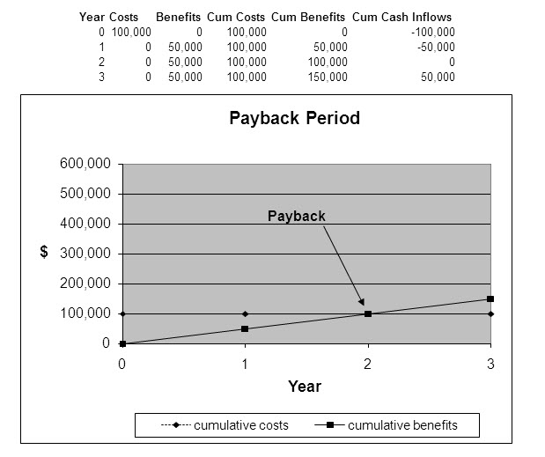
Figure 2-8. Charting the Payback Period

Slide 24
Weighted Scoring Models
A weighted scoring model is a tool that provides a systematic process for selecting projects based on many criteria
To create a weighted scoring model:
Identify criteria important to the project selection process
Assign a weight to each criterion (so they add up to 100 percent)
Assign numerical scores to each criterion for each project
Calculate the weighted scores by multiplying the weight for each criterion by its score and adding the resulting values

Slide 25
Figure 2-9. Sample Weighted Scoring Model for Project Selection

Slide 26
Implementing a Balanced Scorecard
Dr. Robert Kaplan and Dr. David Norton developed another approach to help select and manage projects that align with business strategy
A balanced scorecard is a methodology that converts an organization’s value drivers—such as customer service, innovation, operational efficiency, and financial performance—to a series of defined metrics
Visit www.balancedscorecard.org for more information on using this approach to select projects

Slide 27
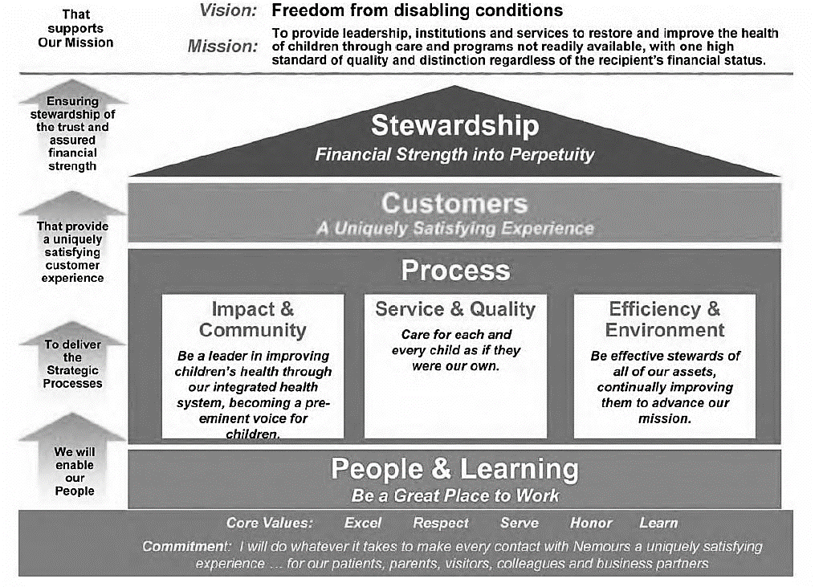
Figure 2-10. Sample Balanced Scorecard Strategy Map (Nemours)

Slide 28
Project Time Frame
Another approach to project selection is based on the time it will take to complete a project or the date by which it must be done
For example, some potential projects must be finished within a specific time period. If they cannot be finished by this set date, they are no longer valid projects
Some projects can be completed very quickly—within a few weeks, days, or even minutes. However, even though many projects can be completed quickly, it is still important to prioritize them

Slide 29
Project Priority
Many organizations prioritize projects as being high, medium, or low priority based on the current business environment
Organizations should always focus on high-priority projects

Slide 30
Program Selection
Recall that a program is a group of related projects, subsidiary programs, and program activities managed in a coordinated manner to obtain benefits not available from managing them individually
After deciding which projects to pursue, organizations need to decide if it is advantageous to manage several projects together as part of a program
There might already be a program that a new project would logically fall under, or the organization might initiate a program and then approve projects for it

Slide 31
Project Portfolio Selection
It’s crucial to focus on enterprise success when creating project portfolios
There may be a need to cancel or put several projects on hold, reassign resources from one project to another, suggest changes in project leadership, or take other actions that might negatively affect individual projects or programs to help the organization as a whole
For example, a university might have to close a campus in order to provide quality services at other campuses

Slide 32
Sample Approaches for Creating a Project Portfolio
Figure 2-11 illustrates one approach for project portfolio management in which there is one large portfolio for the entire organization. Sections of the portfolio are broken down to improve the management of projects in each sector
The IT projects are broken down into three categories:
Venture: Projects that help transform the business
Growth: Projects that help increase revenues
Core: Projects that help run the business

Slide 33
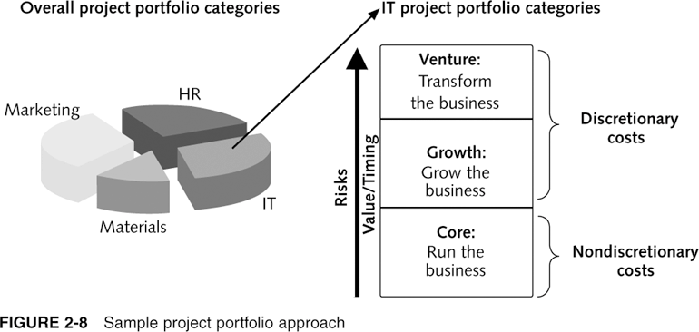
Figure 2-11. Sample Project Portfolio Approach
Schwalbe, Information Technology Project Management, Sixth Edition, 2010

Slide 34
Five Levels of Project Portfolio Management
Put all of your projects in one list
Prioritize the projects in your list
Divide your projects into several categories based on types of investment
Automate the list
Apply modern portfolio theory, including risk-return tools that map project risks

Slide 35
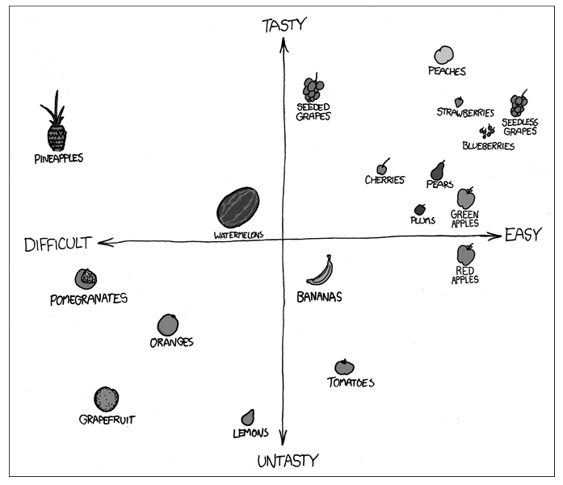
Figure 2-13. Deciding What Fruit to Eat (www.xkcd.com)

Slide 36
Quick Review Question

Slide 37
Summary of Main Teaching Points
An organization’s overall business strategy should guide the project selection process and management of those projects
Many organizations follow a traditional approach, often completed in four stages. To make more timely decisions, they can also use an agile approach.
Several methods are available for selecting projects, including financial methods (net present value, return on investment, and payback); weighted scoring models; balanced scorecards; addressing problems, opportunities, and directives; project time frame; and project priority
The main criteria for program selection are the coordination and benefits available by grouping projects
The goal of project portfolio management is to help maximize business value to ensure enterprise success

Slide 38
Summary of Main Teaching Points
A project is a temporary endeavor undertaken to create a unique product, service, or result
Project management is the application of knowledge, skills, tools, and techniques to project activities to meet project requirements
A program is a group of related projects, subsidiary programs, and program activities managed in a coordinated manner to obtain benefits not available from managing them individually
Project portfolio management involves organizing and managing projects and programs as a portfolio of investments that contribute to the entire enterprise’s success
The project management profession continues to grow and mature, and demand for project manager is high

Slide 39
Question and Answer Session
Q & A

Slide 40
What we will cover next
03 Initiating Projects

